Slide 1
Electronic Components
Avionics
Medical
Military
CJ
ELECTRONICS
www.cj-electronics.com
PH: 561.325.9977

Slide 2
About Us
Our company was incorporates 6 years ago. We are a Broker/reseller of Electronic Components and Miscellaneous Merchandise Sales. NAICS 423690.
We buy and sell components from other brokers(like us) and from manufacturer’s distributors.
If there is ever any doubt as to the authenticity of the parts we will be supplying, these parts can be sent to a Certified Test House.

Slide 3
Our Strategy
Obsolete Parts
Long Lead Time Parts
World wide stock
Replacement
Different mfr
World wide stock
Replacement
Different mfr
Hard To Find Parts
OEM Stock
World Wide Disty Stock
World wide stock
Replacement
Different mfr
World wide stock
Replacement
Different mfr
World wide stock
Replacement
Different mfr

Slide 4
We are an exclusive representative for
HM International
A leading Manufacturer in Belgium of Oscillators and Crystals
www.HMinternational.be
CRYSTALS
OSCILLATORS
MEMS OSCILLATORS
VCXO
TCXO
VCTCXO

Slide 5
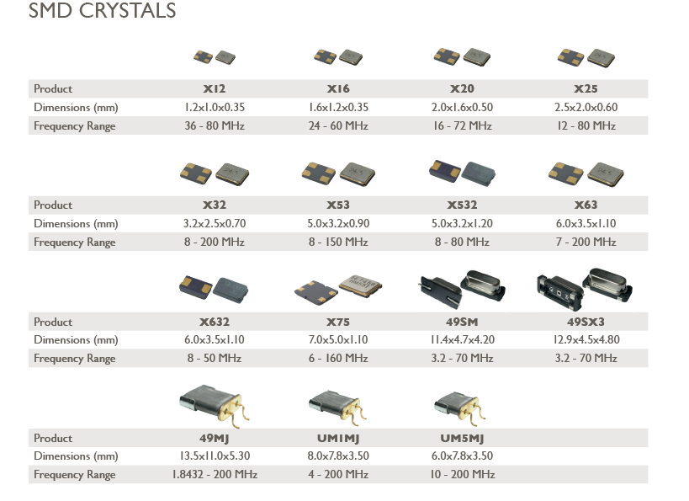

Slide 6
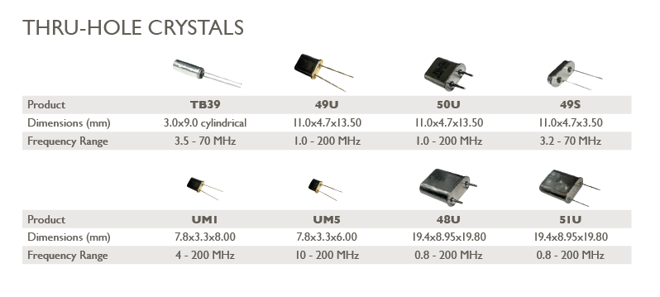

Slide 7
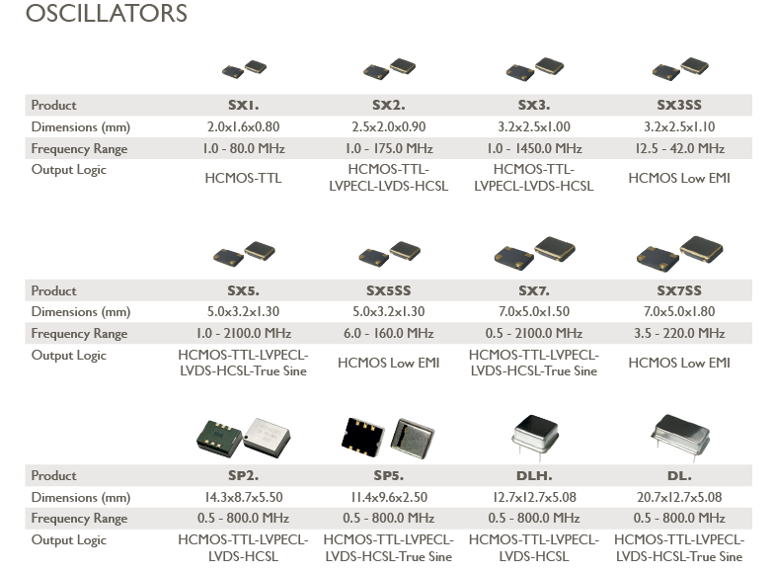

Slide 9
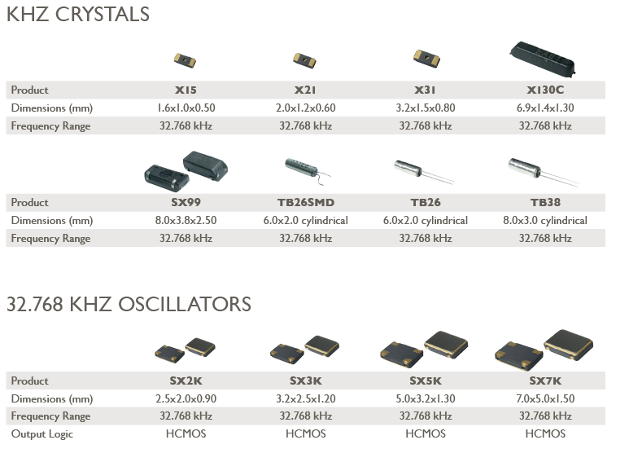

Slide 10
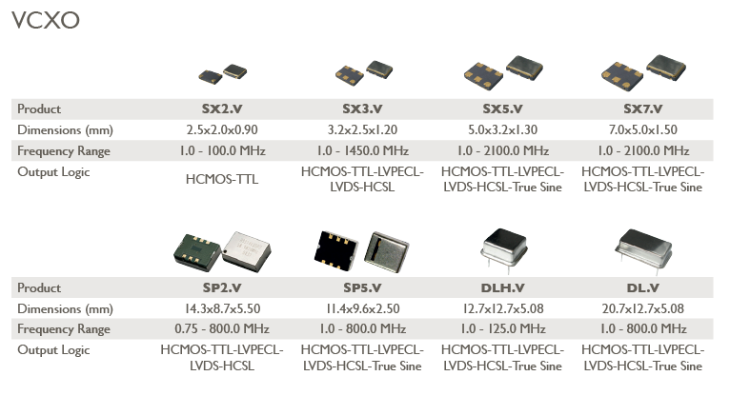

Slide 11
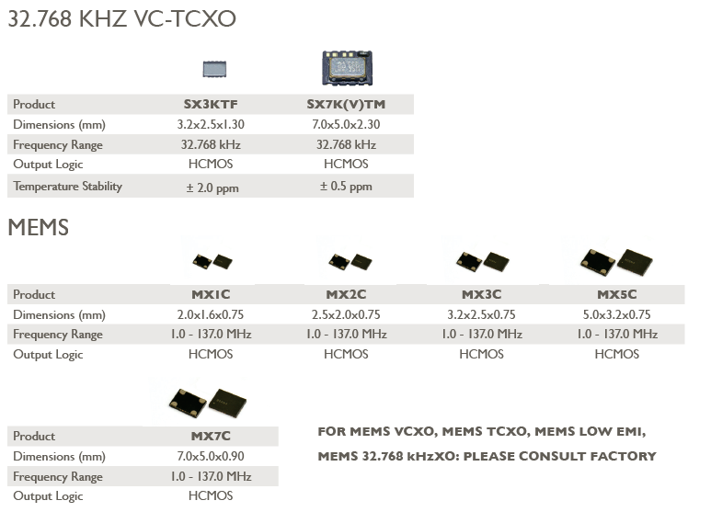

Slide 12
